Slide 1


Slide 2
Course Name :
Middleware Technologies CSIW ZG524

Slide 3
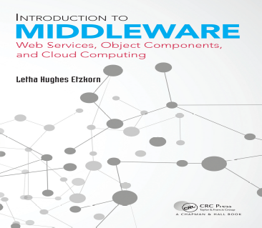
Textbooks
T1: Letha Hughes Etzkorn - Introduction to middleware _ web services, object components, and cloud computing-Chapman and Hall_CRC (2017).
T2: William Grosso - Java RMI (Designing & Building Distributed Applications)
R1: Gregor Hohpe, Bobby Woolf - Enterprise Integration Patterns_ Designing, Building, and Deploying Messaging Solutions -Addison-Wesley Professional (2003)
R2: MongoDB in Action
Note: In order to broaden understanding of concepts as applied to Indian IT industry, students are advised to refer books of their choice and case-studies in their own organizations

Slide 4
Modular Structure
No | Title of the Module
M1 | Introduction and Evolution
M2 | Enterprise Middleware
M3 | Middleware Design and Patterns
M4 | Middleware for Web-based Application and Cloud-based Applications
M5 | Specialized Middleware

Slide 5
CS1: Introduction and Evolution

Slide 6
Agenda
View of Middleware
Forms of Middleware

Slide 7
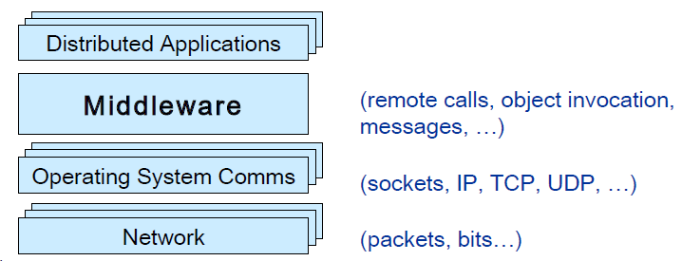
What is Middleware?
Layer between OS and distributed applications
Hides complexity and heterogeneity of distributed system
Bridges gap between low-level OS communications and programming language abstractions
Provides common programming abstraction and infrastructure for distributed applications
Overview at: http://www.middleware.org

Slide 8
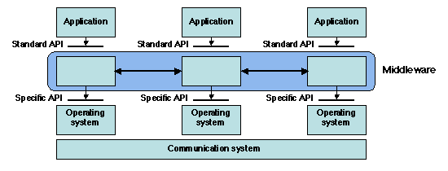
What is Middleware?
“Middleware is the software that connects software components or enterprise applications in a distributed system”.
Examples: Enterprise Application Integration software, telecommunications software, transaction monitors, and messaging-and-queueing software.

Slide 9
Cont.
Middleware provides support for (some of):
  Naming, Location, Service discovery, Replication
  Protocol handling, Communication faults, QoS
  Synchronization, Concurrency, Transactions, Storage
  Access control, Authentication
Middleware dimensions:
– Request/Reply | vs. | Asynchronous Messaging
– Language-specific | vs. | Language-independent
– Proprietary | vs. | Standards-based
– Small-scale | vs. | Large-scale
– Tightly-coupled | vs. | Loosely-coupled components

Slide 10
Common Forms of MW
Sockets
Remote Procedure Calls
Distributed Object-Oriented Components (Ex: ORB)
Message Oriented Middleware (Message Queues/Enterprise Message Bus etc.)
Service Oriented Architectures
Web services (Arbitrary / RESTful)
SQL-oriented data access
Embedded middleware
Cloud Computing

Slide 11
Sockets
Socket is an internal endpoint for sending/receiving data within a node on network
Berkeley/POSIX sockets defined API for Inter Process Communication (IPC) within same host (BSD 4.2 – circa 1983)
Early form of Middleware (limited to same host systems)
Windows variant (WinSock) based on BSD Sockets.
Treated similar to files in BSD/POSIX
Maintained in File Descriptor table
Supported protocols
  TCP/IP – IPv4, IPv6
  UDP

Slide 12
Sockets API
socket —creates a descriptor for use in network communications
connect —connect to a remote peer (client)
write —send outgoing data across a connection
read —acquire incoming data from a connection
close —terminate communication and deallocate a descriptor
bind —bind a local IP address and protocol port to a socket
listen —set the socket listening on the given address and port for connections from the client and set the number of incoming connections from a client (backlog) that will be allowed in the listen queue at any one time
accept —accept the next incoming connection (server)
recv —receive the next incoming datagram
recvmsg —receive the next incoming datagram (variation of recv)
recvfrom —receive the next incoming datagram and record its source endpoint address
send —send an outgoing datagram
sendmsg —send an outgoing datagram (variation of send)
sendto —send an outgoing datagram, usually to a prerecorded endpoint address
shutdown —terminate a TCP connection in one or both directions
getpeername —after a connection arrives, obtain the remote machine’s endpoint address from a socket
getsockopt —obtain the current options for a socket
setsockopt —change the options for a socket

Slide 13
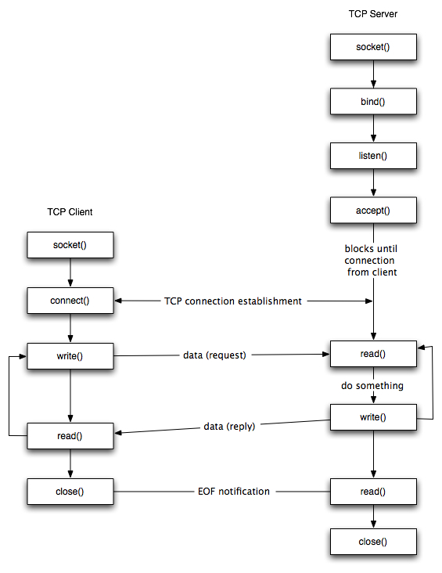
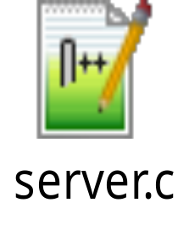
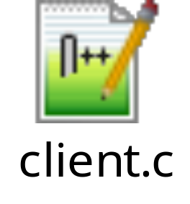
Sockets - Life Cycle
TCP Client – Server example
#Server
#Client

Slide 14
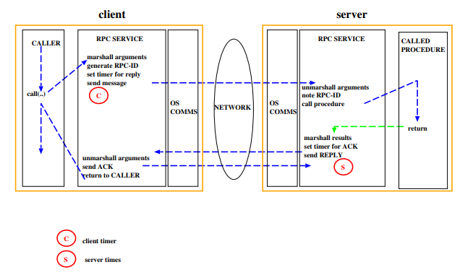
Remote Procedure Call (RPC)
Mask's remote function calls as being local Client/server model
Request/reply paradigm usually implemented with message passing in RPC service
Marshalling of function parameters and return value

Slide 15
Remote Procedure Call (RPC)
Properties of RPC
Language-level pattern of function call
  easy to understand for programmer
Synchronous request/reply interaction
  natural from a programming language point-of-view matches replies to requests
  built in synchronization of requests and replies
Distribution transparency (in the no-failure case)
  hides the complexity of a distributed system
Various reliability guarantees
  deals with some distributed systems aspects of failure
Failure Modes of RPC
Invocation semantics supported by RPC in the light of : network and/or server congestion, client, network and/or server failure. Note DS independent failure modes
RPC systems differ, many examples, local was Mayflower
May be or at most once( RPC system tries once) Error return – programmer may retry
Exactly once (RPC system retries a few times)
  Hard error return – some failure most likely note that “exactly once” cannot be guaranteed

Slide 16
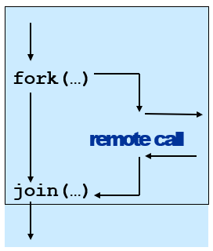
Remote Procedure Call (RPC)
Disadvantages of RPC
Synchronous request/reply interaction
  tight coupling between client and server
  client may block for a long time if server loaded leads to multi-threaded programming at client
  slow/failed clients may delay servers when replying multi-threading essential at servers
Distribution Transparency
  Not possible to mask all problems
RPC paradigm is not object-oriented
  invoke functions on servers as opposed to methods on objects

Slide 17
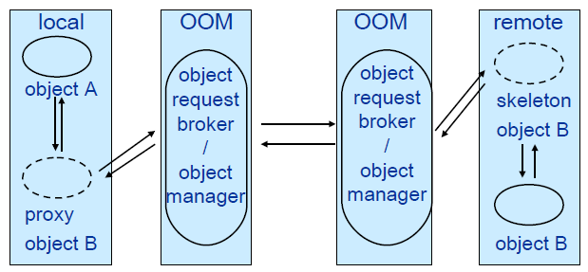
Object-Oriented Middleware (OOM)
Objects can be local or remote
Object references can be local or remote
Remote objects have visible remote interfaces
Masks remote objects as being local using proxy objects Remote method invocation
Properties of OOM
Support for object-oriented programming model
  objects, methods, interfaces, encapsulation…
  exceptions (were also in some RPC systems e.g. Mayflower)
Synchronous request/reply interaction
  same as RPC
Location Transparency
  system (ORB) maps object references to locations
Services comprising multiple servers are easier to build with OOM
  RPC programming is in terms of server-interface (operation)
  RPC system looks up server address in a location service

Slide 18
Java Remote Method Invocation (RMI)
public interface PrintService extends Remote
{
int print(Vector printJob) throws RemoteException;
}
Distributed objects in Java
RMI compiler creates proxies and skeletons
RMI registry used for interface lookup
Entire system written in Java (single-language system)

Slide 19
CORBA
Common Object Request Broker Architecture
  Open standard by the OMG (Version 3.0)
  Language- and platform independent
Object Request Broker (ORB)
  General Inter-ORB Protocol (GIOP) for communication
  Interoperable Object References (IOR) contain object location
  CORBA Interface Definition Language (IDL)
    Stubs (proxies) and skeletons created by IDL compiler
  Dynamic remote method invocation
Interface Repository
  Querying existing remote interfaces
Implementation Repository
  Activating remote objects on demand

Slide 20
CORBA IDL
Definition of language-independent remote interfaces
  Language mappings to C++, Java, Smalltalk, …
  Translation by IDL compiler
Type system
  basic types: long (32 bit),
  long long (64 bit), short, float, char, boolean, octet, any, …
  constructed types: struct, union, sequence, array, enum
  objects (common super type Object)
Parameter passing
  in, out, inout
  basic & constructed types passed by value
  objects passed by reference
CORBA Services
Naming Service
  Names → remote object references
Trading Service
  Attributes (properties) → remote object references
Persistent Object Service
  Implementation of persistent CORBA objects
Transaction Service
  Making object invocation part of transactions
Event Service and Notification Service
  In response to applications‘ need for asynchronous communication
  built above synchronous communication with push or pull options
  not an integrated programming model with general IDL messages
typedef sequence<string> Files; interface PrintService : Server {
void print(in Files printJob); };

Slide 21
CORBA - Disadvantages
Synchronous request/reply interaction only
  So CORBA oneway semantics added and -
  Asynchronous Method Invocation (AMI)
  But implementations may not be loosely coupled
Distributed garbage collection
  Releasing memory for unused remote objects
OOM rather static and heavy-weight
  Bad for ubiquitous systems and embedded devices

Slide 22
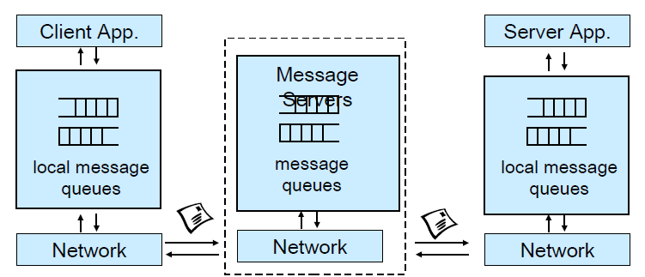
Message-Oriented Middleware (MOM)
Communication using messages
Messages stored in message queues
message servers decouple client and server
Various assumptions about message content
Properties of MOM
Asynchronous interaction
  Client and server are only loosely coupled
  Messages are queued
  Good for application integration
Support for reliable delivery service
  Keep queues in persistent storage
Processing of messages by intermediate message server(s)
  May do filtering, transforming, logging, …
  Networks of message servers
Natural for database integration

Slide 23
Message-Oriented Middleware (MOM)
IBM MQ-Series
One-to-one reliable message passing using queues
  Persistent and non-persistent messages
  Message priorities, message notification
Queue Managers
  Responsible for queues
  Transfer messages from input to output queues
  Keep routing tables
Message Channels
  Reliable connections between queue managers
Java Messaging Service (JMS)
API specification to access MOM implementations
Two modes of operation *specified*:
Point-to-point: one-to-one communication using queues
Publish/Subscribe: Event-Based Middleware
JMS Server implements JMS API
JMS Clients connect to JMS servers
Java objects can be serialised to JMS messages
A JMS interface has been provided for MQ
pub/sub (one-to-many) - just a specification?

Slide 24
MOM - Disadvantages
Poor programming abstraction (but has evolved)
  Rather low-level (cf. Packets)
  Request/reply more difficult to achieve, but can be done
Message formats originally unknown to middleware
  No type checking (JMS addresses this – implementation?)
Queue abstraction only gives one-to-one communication
  Limits scalability (JMS pub/sub – implementation?)

Slide 25
Web Services
Use well-known web standards for distributed computing
Communication
  • Message content expressed in XML
  • Simple Object Access Protocol (SOAP)
    – Lightweight protocol for sync/async communication
Service Description
  • Web Services Description Language (WSDL)
    – Interface description for web services
Service Discovery
  • Universal Description Discovery and Integration (UDDI)
    – Directory with web service description in WSDL
Properties of Web Services
Language-independent and open standard
SOAP offers OOM and MOM-style communication:
  Synchronous request/reply like OOM
  Asynchronous messaging like MOM
  Supports internet transports (http, smtp, ...)
  Uses XML Schema for marshalling types to/from programming language types
WSDL says how to use a web service
  http://api.google.com/Google Search.wsdl
UDDI helps to find the right web service
  Exports SOAP API for access

Slide 26
Web Services
Disadvantages of WS
Low-level abstraction
  leaves a lot to be implemented
Interaction patterns have to be built
  one-to-one and request-reply provided
  one-to-many?
  still synchronous service invocation, rather than notification
  No nested/grouped invocations, transactions, ...
No location transparency
What we lack so far ?
General interaction patterns
  we have one-to-one and request-reply
  one-to-many? many to many?
  notification?
  dynamic joining and leaving?
Location transparency
  anonymity of communicating entities
Support for pervasive computing
  data values from sensors
  lightweight software

Slide 27
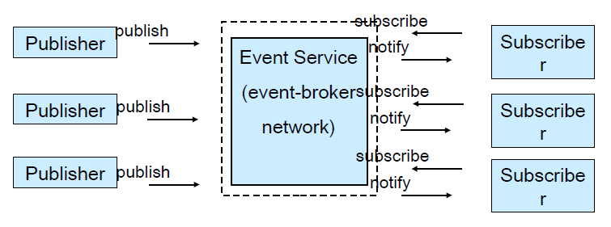
Event-Based Middleware a.k.a. Publish/Subscribe
Publishers (advertise and) publish events (messages)
Subscribers express interest in events with subscriptions
Event Service notifies interested subscribers of published events
Events can have arbitrary content (typed) or name/value pairs

Slide 28
Topic-Based and Content-Based Pub/Sub
Event Service matches events against subscriptions
  What do subscriptions look like?
Topic-Based Publish/Subscribe
  Publishers publish events belonging to a topic or subject
  Subscribers subscribe to a topic subscribe(PrintJobFinishedTopic, …)
(Topic and) Content-Based Publish/Subscribe
  Publishers publish events belonging to topics and
  Subscribers provide a filter based on content of events
  subscribe(type=printjobfinished, printer=‘aspen’, …)
Properties of Pub/Sub
Asynchronous communication
  Publishers and subscribers are loosely coupled
Many-to-many interaction between pubs. and subs.
  Scalable scheme for large-scale systems
  Publishers do not need to know subscribers, and vice-versa
  Dynamic join and leave of pubs, subs,
(Topic and) Content-based pub/sub very expressive
  Filtered information delivered only to interested parties
  Efficient content-based routing through a broker network

Slide 29
Summary
Middleware is an important abstraction for building distributed systems
  Remote Procedure Call
  Object-Oriented Middleware
  Message-Oriented Middleware
  Event-Based Middleware
Synchronous vs. asynchronous communication
Scalability, many-to-many communication
Language integration
Ubiquitous systems, mobile systems

Slide 30
Thank You

Slide 31


